Slide 1

Decision Support System to Predict Credit Card Fraud
Presented by: A Team
Abhishek Dangi(12736625)
Lohit Ravindra(12795389)
Richa Vyas(12640304)

Slide 2
Agenda
Problem Statement
Types of Fraud
Model Analysis
Credit Card Fraud Detection Algorithms
Case Study: E-TAIL
Methodologies
Decision Support Analysis
Cconclusion and Future Work
References

Slide 3

Problem Statement
To understand the processes involved in detection of credit card frauds and how they help in decision making.

Slide 4
Top 10 Frauds in Banking Sector
Credit Cards
Deposits – Savings A/C
Internet Banking
Housing Loans
Term Loans
Cheque / Demand Drafts
Cash Transactions
Cash Credit A/c (Types of Overdraft A/C]
Advances
ATM / Debit Cards

Slide 5

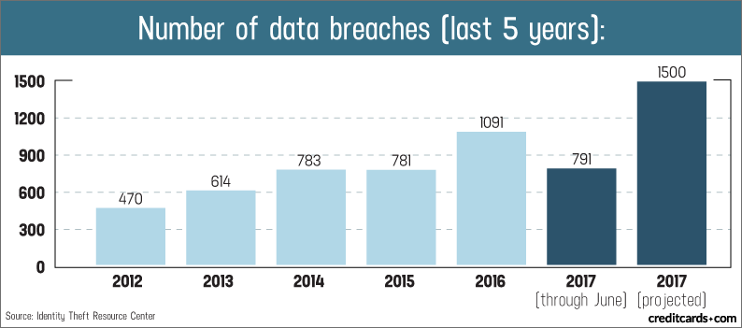
Credit Card Frauds
The Highly publicized credit cards stolen details and leaked in the dark web are:
• EBay: 145 million records accessed.
• Home Depot: 109 million records accessed.
• JP Morgan Chase: 83 million records accessed.
• Michael's Stores: 3 million records accessed.
• Staples: 1.16 million records accessed.
• Domino's Pizza: 650,000 records accessed.
• Sony Pictures Entertainment: 47,000 records accessed.
• Target: 40 million credit card numbers and 70 million addresses accessed.
• Nieman Marcus: 350,000 cardholders impacted.
Notes:
https://www.creditcards.com/credit-card-news/credit-card-security-id-theft-fraud-statistics-1276.php
https://www.nasdaq.com/article/credit-card-fraud-and-id-theft-statistics-cm520388

Slide 6
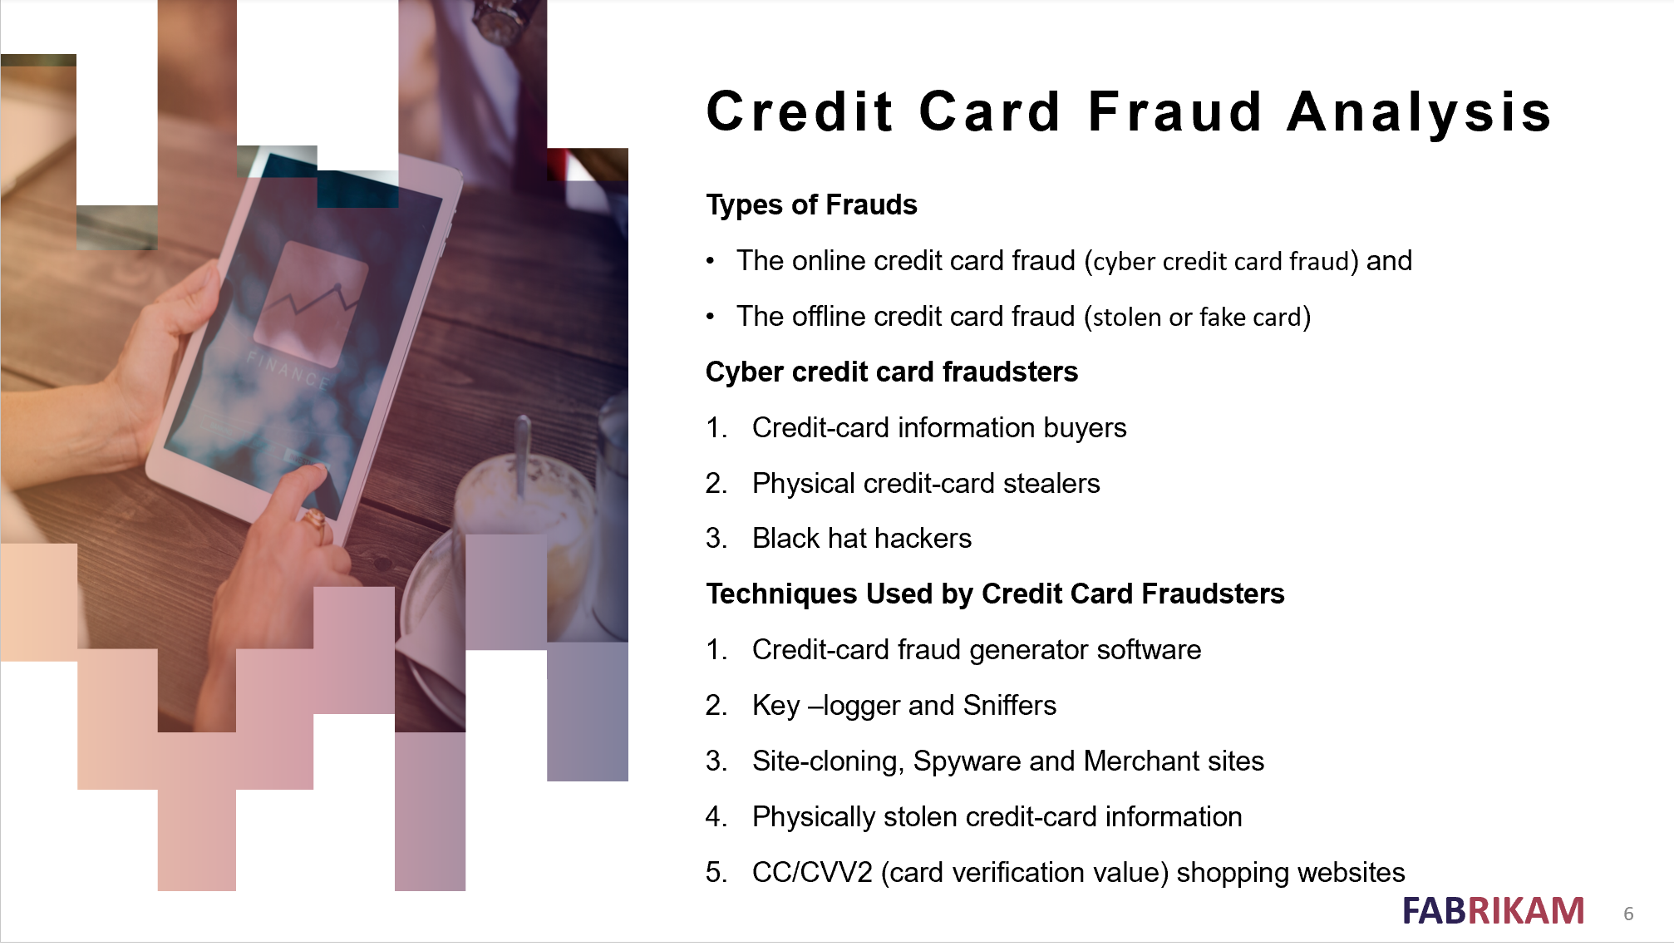

Slide 7
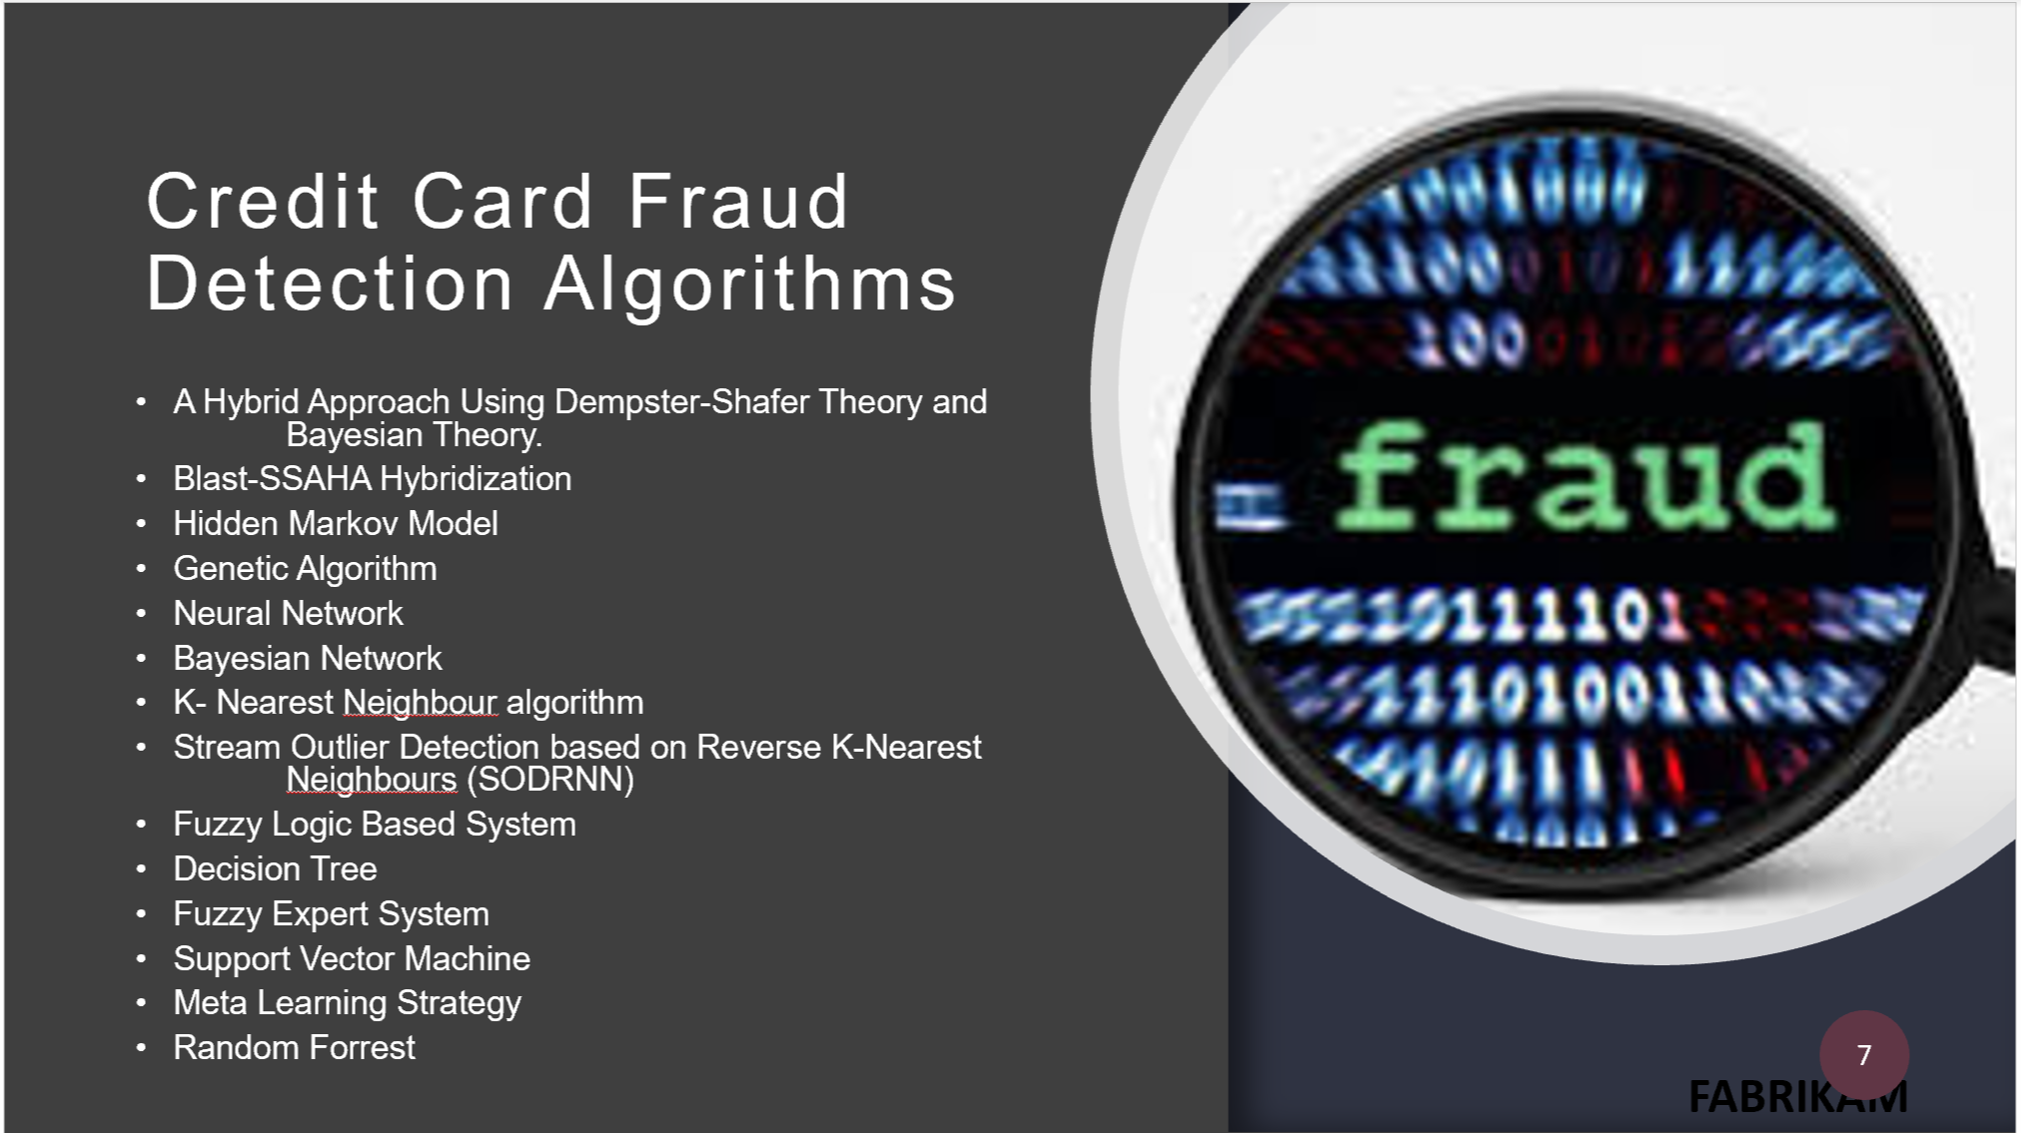

Slide 8
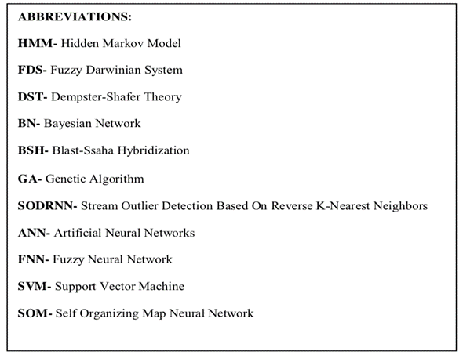
Model Analysis – Comparative Study
Models | HMM | FDS | DST & BN | BSH | GA | SODRN | ANN | Meta-learning | FNN | SVM | SOM
Accuracy | Low | Very High | High | High | Medium | Medium | Medium | High | Good | Medium | Medium
Speed of Detection | Fast | Very low | Low | Good | Good | Good | Fast | Low | Very fast | Low | Fast
Cost | Very Expensive | Very Expensive | Expensive | Moderate | Inexpensive | Expensive | Expensive | Expensive | Expensive | Expensive | Expensive

Slide 9
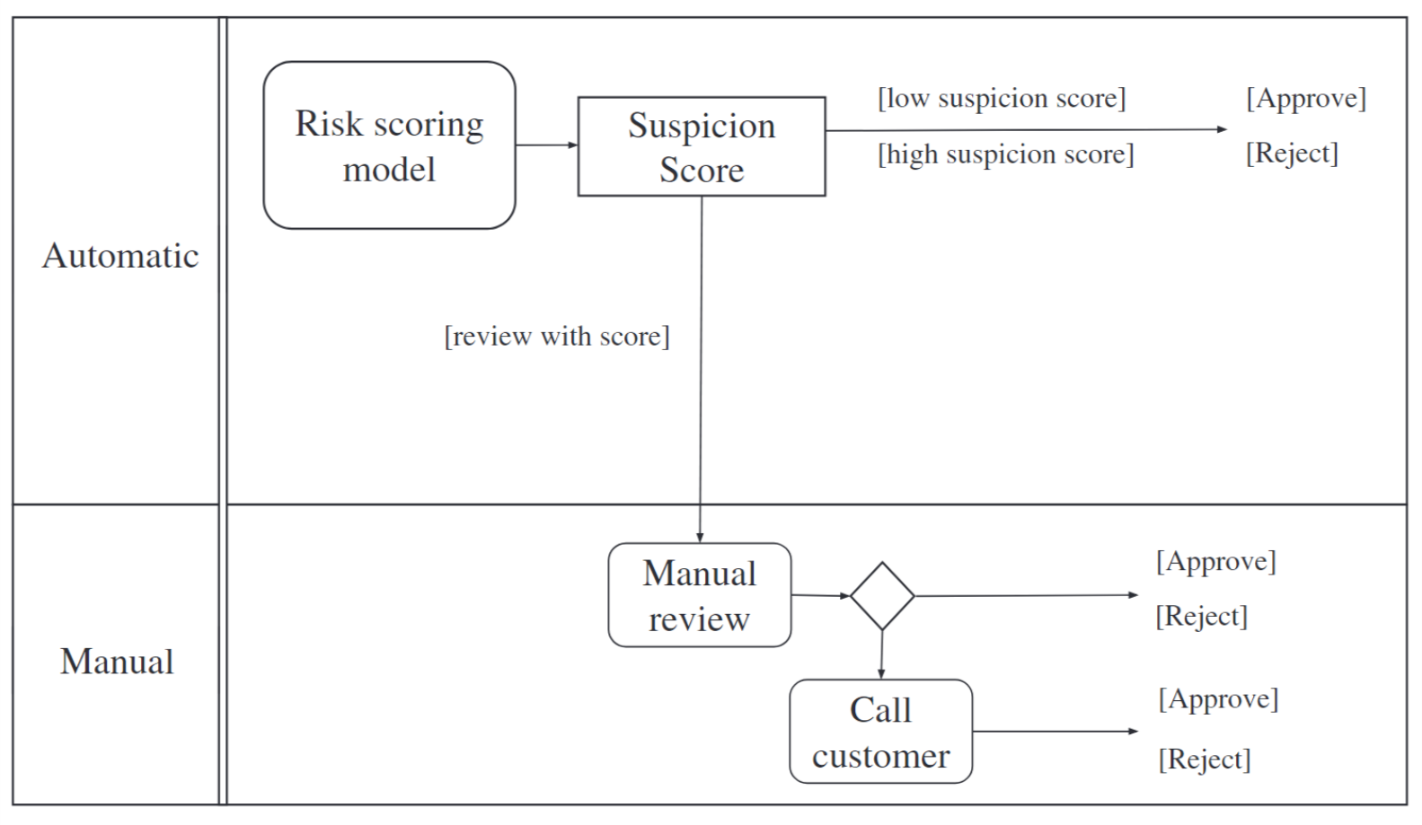
Case Study : E-TAIL
The objective of the company is to develop a system which will result in a higher automation level, while not increasing the charge-back level and the rate of refused payments.
In the medium-term the new process should allow the company to reach
A level of automation of 80%,
With a chargeback level under 1% and
A refused payment rate under 4.5%

Slide 10
Data Mining Methodology
Data understanding and preparation
Data collection
Variables’ transformations
Modelling and evaluation
Random Forrest
Linear Regression
SVM

Slide 11

Data Understanding
This section describes the reasoning behind the building of the data set for this project.
Handling the data was done with Python version 3.6.
Two particular modules for Python, Pandas data structures and Scikit-learn, were especially useful for running the algorithm.

Slide 12
Data collection
Here we collect all the transactional data. This data contains all the legitimate as well as fraudulent transactions.
Two criteria are taken into consideration when defining the classes of the dataset and we created a variable which is called Label Fraud with a value of 0 or 1, such that:
An order that originated a chargeback or was manually marked as fraudulent was labelled as fraudulent (Label Fraud= 1); and
All other orders were labelled as legitimate transactions (Label Fraud=0).

Slide 13
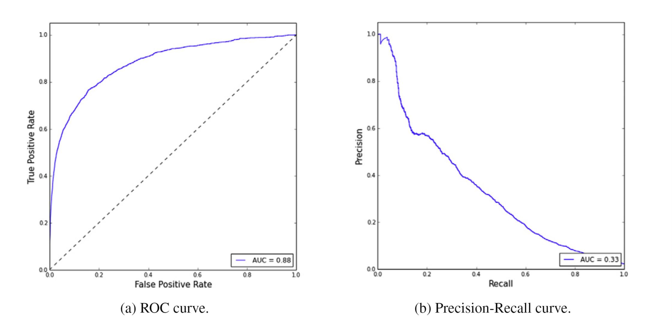
Modelling and evaluation
Performance Measures
Cross Validation
Results of Cross Validation
Random Forests (Best)
Support Vector Machines
Logistic regression
Testing results
Classifier | AUC-PR | AUC-ROC
Random Forrest | 0.333 | 0.880

Slide 14

Decision Support Analysis-Approach
This approach estimates the performance in the case that all orders are automatically approved or rejected in accordance with their suspicion score.
This is the point where Recall ($\frac{True Positives}{TruePositives+FalseNegatives}$) and Specificity $(\frac{True Negatives}{True Negatives+False Positives})$ have the same value, which achieves the compromise between the two measures.
Confusion matrix When Setting Threshold at c = 0.22
 | Legitimate (Actual) | Fraud (Actual) | Total
Legitimate (Predict) | 77129 (88.76%) | 618 (0.71%) | 77, 747
Fraud (Predict) | 7904 (9.09%) | 1242 (1.42%) | 9146

Slide 15
Decision Support Analysis-Variable Importance
Relative Importance of the top 10 Attributes
Importance | Feature | Description
13.3% | Time Since First order | Time elapsed since user’s first purchase at this merchant
10.3% | Order Value | Value of Order
7.6% | Brand | All the features describing the product brand
6.3% | ShipCity_RiskLevel | Engineered variable - risk level associated with shipping city
6.1% | Quantity | Quantity of items in the order
5.9% | Gender | Gender of items in the order
5.4% | Similarity (UserName/CardName) | Engineered variable - similarity between username and name on credit card
4.9% | Name Cards Used | Number of cards used by customer at this merchant
4.9% | Payment Attempts | Payment attempts by user for this order
4.6% | Order Time GMT | Absolute time at which the order is placed
The random forests model allows us to estimate the relative importance of each of the features. We can see the importance of the top 10 attributes
The information we get from this analysis can be of use to improve the manual revision process and inbuilding new models in the future.

Slide 16

Conclusion and Future Research
We have addressed all the data mining techniques used in the banking sector with a special in-depth literature review of Fraud detection in Credit Cards.
Random forests achieved the highest performance in the case study.
Predictive algorithms can be used to get optimal decisions.
Future Research: To explore whether oversampling of fraudulent records would lead to a different conclusion.
This report is a good starting point for any fraud analyst to understand credit card fraud and the techniques in place to tackle it.

Slide 17
References
Chan, S.W. &amp; Franklin, J. 2011, &#39;A text-based decision support system for financial sequence prediction&#39;, Decision Support Systems, vol. 52, no. 1, pp. 189-98.
Chitra, K. &amp; Subashini, B. 2013, &#39;Data mining techniques and its applications in banking sector&#39;, International Journal of Emerging Technology and Advanced Engineering, vol. 3, no. 8, pp. 219-26.
Jha, S. &amp; Westland, J.C. 2013, &#39;A descriptive study of credit card fraud pattern&#39;, Global Business Review, vol. 14, no. 3, pp. 373-84.
Mahmoudi, N. &amp; Duman, E. 2015, &#39;Detecting credit card fraud by modified Fisher discriminant analysis&#39;, Expert Systems with Applications, vol. 42, no. 5, pp. 2510-6.
Nuno Carneiroa, G. F. b. M. C., 2017. A data mining based system for credit-card fraud detection in e-tai. Decision Support Systems, pp. 91-101. Quah, J.T. &amp; Sriganesh, M. 2008, &#39;Real-time credit card fraud detection using computational intelligence&#39;, Expert systems with applications, vol. 35, no. 4, pp.1721-32.
Suraj Patil, V. N. P. S., 2018. Predictive Modelling For Credit Card Fraud Detection Using Data Analytics. In: Procedia Computer Science 132 (2018). s.l.:International Conference on Computational Intelligence and Data Science (ICCIDS 2018), pp. 385 -395. SurveyIvan Herman, M. C. S. G. M. o. a. M. S. M., 2000. Graph Visualization and Navigation inInformation Visualization: A Survey. IEEE TRANSACTIONS ON VISUALIZATION AND COMPUTER GRAPHICS, p. 24.
Seeja, K. &amp; Zareapoor, M. 2014, &#39;FraudMiner: A novel credit card fraud detection model based on frequent itemset mining&#39;, The Scientific World Journal, vol. 2014.
Sharma, A. &amp; Panigrahi, P.K. 2013, &#39;A review of financial accounting fraud detection based on data mining techniques&#39;, arXiv preprint arXiv:1309.3944.
Sethi, N. &amp; Gera, A. 2014, &#39;A revived survey of various credit card fraud detection techniques&#39;, International Journal of Computer Science and Mobile Computing, vol.3, no. 4, pp. 780-91.
Thiago Poleto(✉), V. D. H. d. C. a. A. P. C. S. C., 2015. The Roles of Big Data in the Decision-Support Process. In: 2015ProceedingsDecision Support Systems V – Big Data Analytics forDecision MakingBoris . s.l.:s.n., pp. 10-21.
Van Vlasselaer, V., Bravo, C., Caelen, O., Eliassi-Rad, T., Akoglu, L., Snoeck, M. &amp; Baesens, B. 2015, &#39;APATE: A novel approach for automated credit card transaction fraud detection using network-based extensions&#39;, Decision Support Systems, vol. 75, pp. 38-48.
Wang, C. and Han, D., 2018. Credit card fraud forecasting model based on clustering analysis and integrated support vector machine. Cluster Computing, pp.1-6. West, J. and Bhattacharya, M., 2016. Intelligent financial fraud detection: a comprehensive review. Computers & security, 57, pp.47-66.

Slide 18
THANK YOU Questions?

